Slide 1



Text Enhancement of Photographs Taken with a Moving Smartphone
Jian pan 5728309 xiaohan yu 5718303
Advisor: Asst. Prof. Dr. Dobri Atanassov Batovski

Slide 2

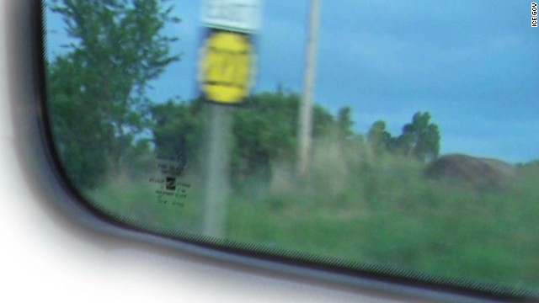
Introduction and background
Project background
A blurred road sign clue to saving a girl was published by the CNN in 2013.
In the news policemen confused the number on sign was 203 or 200
“so Cole and the other agents got back on the road and started driving every highway in Kansas that starts with a 2.”
Source: Coorlim, L., Agents racing to save girl had one blurred clue, CNN, 20 June 2013, Available: <https://edition.cnn.com/2013/06/19/us/cfp-us-race-against-time/index.html>.

Slide 3

Introduction and background
This is a classic image-deblurring problem in image processing field
This core thing of this task is about how to find blur kernel.
$I=L⊗f+n$,
If we can find the variation $f$, the problem is solved.
How can we do?

Slide 4

Literature Review
Early works about image deblurring focuses on non-blind deblurring ------ we know $f$
A lot of classic algorithms/filters can do that. We call it deconvolution.
For example, Lucy-Richardson
Wiener
Tikhonov
Even Poission distribution.

Slide 5

Literature Review
Blind deblurring ------ we do not know $f$
Before 1996-1998, the general belief was that
blind deconvolution was not just impossible, but that it was hopelessly impossible [11]
The main difficulty in solving blind deconvolution is that the problem is ill-posed

Slide 6
Literature Review
However, people do not stop studying and researching.
After 2006, as starting with the success of Fergus et al. [6],
using an assumption on the statistical property of the image gradient distribution to approximate the unblurred image
That is a milestone in image processing field, especially image-deblurring.

Slide 7

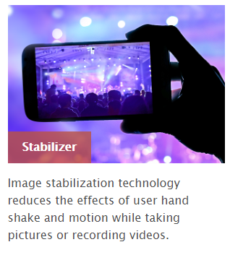
Literature Review
Convolutional Neural Networks
With the success of deep learning, over the last few years, there appeared some approaches based on convolutional neural networks (CNNs).
Kupyn et al. [11] presented an approach, which is based on conditional GANs and content loss.
Hardware Approach
The first approach uses optically stabilized lenses for camera shake compensation.
The second approach uses specially designed CMOS sensors.
Sindelar and Sroubek [20] utilized inertial sensors (accelerometers and gyroscopes) in modern smartphones to detect exact motion

Slide 8
Methodology
(a) is an original image.
(b) is the result after convolution with blurred kernel.
(c) is the deblurred image with the Richardson-Lucy algorithm after 15 iterations.
(D) Result of restoration with Wiener Filter

Slide 9
Methodology
(a) is the noisy image obtained with a built-in noise function;
(b) is the deblurred image with the Richardson-Lucy algorithm; and
(c) is the deblurred image with the Wiener filter.

Slide 10
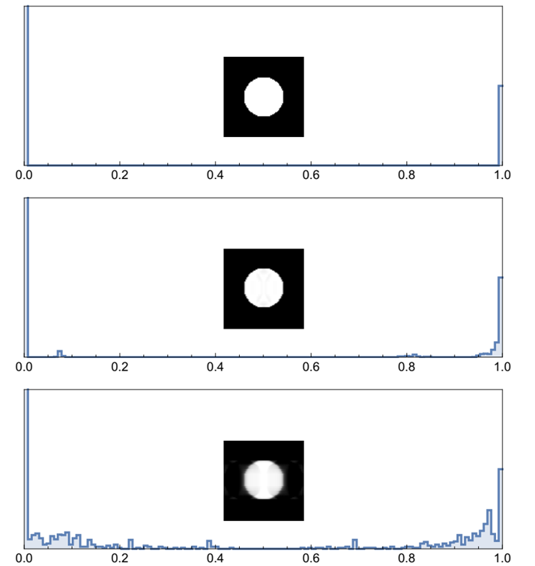
Results and Analysis
Histograms of RL and Wiener filters without noise.

Slide 11
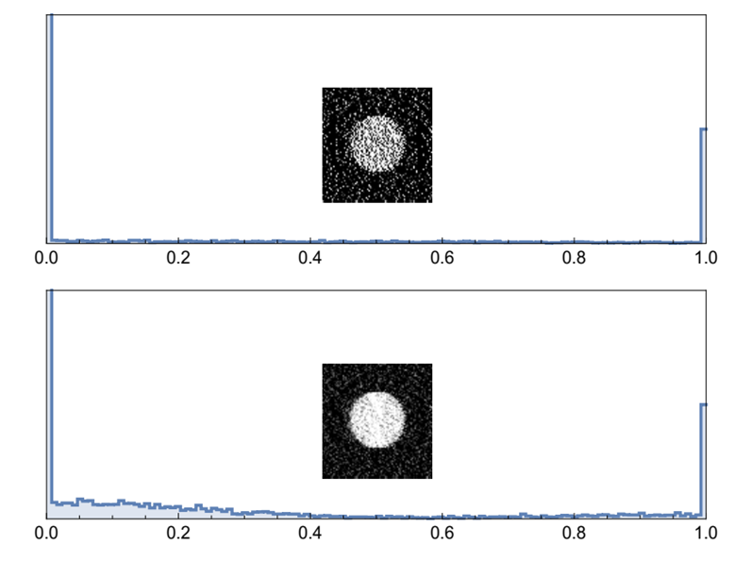
Results and Analysis
Histograms of RL and Wiener filters with noise.

Slide 12
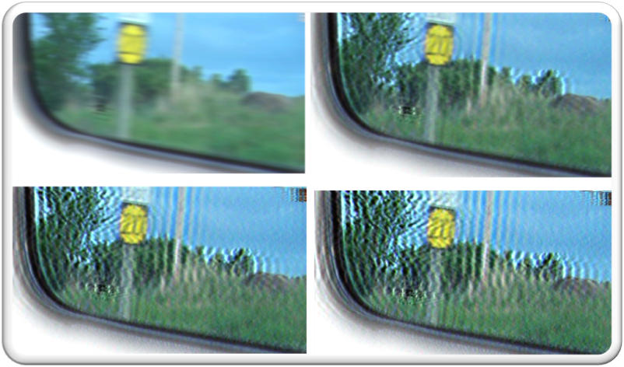
How about time
Iteration | 1 | 5 | 10 | 15 | 20 | 25 | 30 | 35 | 40 | 45
Time, s | 0.16 | 0.48 | 0.92 | 1.36 | 1.78 | 2.3 | 2.69 | 3.09 | 3.55 | 4.11
Iteration | 50 | 55 | 60 | 65 | 70 | 75 | 80 | 85 | 90 | 100
Time, s | 4.55 | 4.88 | 5.3 | 5.8 | 6.16 | 6.66 | 7.11 | 7.66 | 8.08 | 8.89

Slide 13
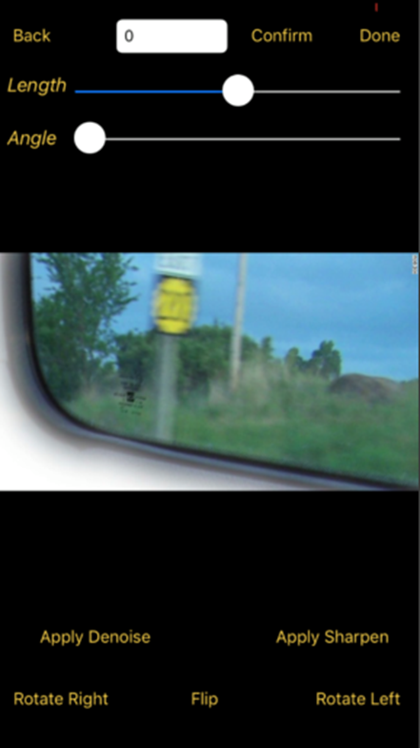
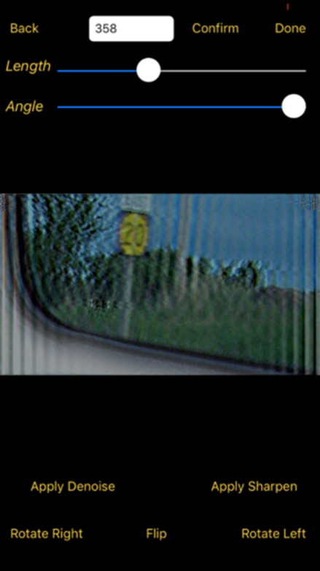
The result of iOS demo app

Slide 14


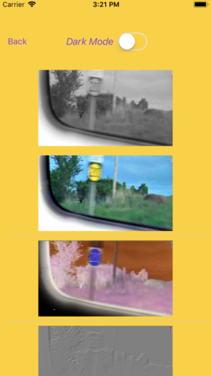
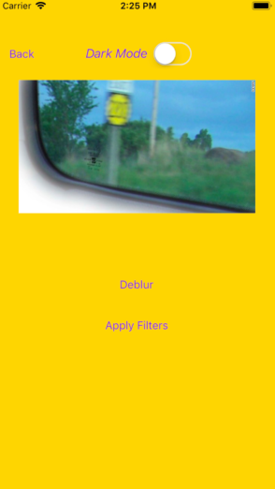
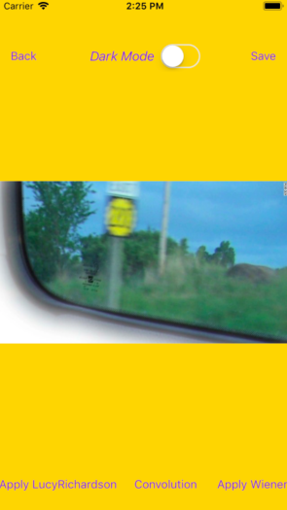
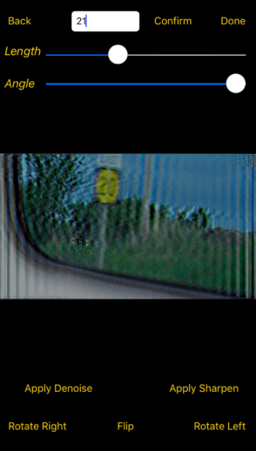
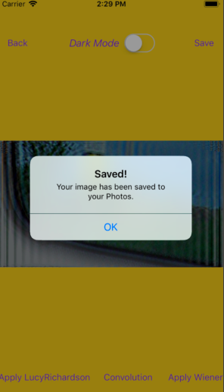
Big priest

Slide 15
Conclusion and Future Work
The main unique contributions of this project are listed below:
1) The capability of the Wiener filter to successfully reconstruct the textual content of images with motion blur has been successfully tested using a blurred image from a law enforcement case which resisted previous computational efforts [4].
2) A basic software platform for testing different deblurring filtering techniques has been developed using the Wolfram programming language (see Appendices A and B).
A smart phone app written in Swift with OpenCV has been developed being capable of reconstructing blurred textual content within a few seconds only (see Appendix C).
As a future work, CNNs and GANs modified for reduced processing power and energy consumption could possibly be used for image deblurring on smart phones. Machine learning gives another opportunity to restore blurred images without estimating the kernel.

Slide 16
Acknowledgements
We are indebted to Asst. Prof. Dr. Dobri Atanassov Batovski, A. Chayapol Moemeng and Asst. Prof. Paitoon Porntrakoon for their insights and suggestions.
We are also most grateful to A. Tapanan Yeophantong, Dr. Kwankawol Nongpong and Dr. Rachsuda Setthawong for their constructive comments.

Slide 17
References
[1] Allon, S. H. M., Debertrand, M. G., and Sleutjes, B. T. H. M., Fast Deblurring Algoithrms, Project Report, Department of Biomedical Engineering, Eindhoven University of Technology, Eindhoven, The Netherlands, 2004.
[2] Babacan, S. D., Molina, R., Do, M. N., and Katsaggelos, A. K., Bayesian blind deconvolution with general sparse image priors, In: Proceedings of the European Conference on Computer Vision (ECCV), Firenze, Italy, 7-13 October 2012, pp. 341-355, Lecture Notes in Computer Science, Vol. 7577, Springer, Heidelberg, Germany.
[3] Canon Inc., New Canon Hybrid IS world's first image stabilizer to compensate for two types of camera shake, Tokyo, Japan, 22 July 2009, Available: <https://global.canon/en/news/2009/jul22e.html>.
[4] Coorlim, L., Agents racing to save girl had one blurred clue, CNN, 20 June 2013, Available: <https://edition.cnn.com/2013/06/19/us/cfp-us-race-against-time/index.html>.
[5] Donatelli, M., Estatico, C., Martinelli, A., and Serra-Capizzano, S., Improved image deblurring with antireflective boundary conditions and re-blurring, Inverse Problems, 22(6): 2035-2053, October 2006.
[6] Fergus, R., Singh, B., Hertzmann, A., Roweis, S. T., and Freeman, W. T., Removing camera shake from a single photograph, ACM Transactions on Graphics, 25(3): 787-794, July 2006.
[7] Gong, D., Yang, J., Liu, L., Zhang, Y., Reid, I., Shen, C., Van Den Hengel, A., and Shi, Q., From motion blur to motion flow: A deep learning solution for removing heterogeneous motion blur, In: Proceedings of the IEEE Conference on Computer Vision and Pattern Recognition (CVPR), Honolulu, Hawaii, USA, 21-26 July 2017, pp. 3806-3815.
[8] Gonzalez, R. C., and Woods, R. E., Digital Image Processing, 4th ed., Pearson, New York, NY, USA.
[9] Jansson, P. A., Deconvolution of Images and Spectra, 2nd ed., Academic Press, Academic Press, Orlando, FL, USA, 1996.
[10] Jia, J., Single image motion deblurring using transparency. In: Proceedings of the IEEE Conference on Computer Vision and Pattern Recognition (CVPR), Minneapolis, MN, USA, 17-22 June 2007, 8 pp.

Slide 18
References
[11] Kupyn, O., Budzan, V., Mykhailych, M., Mishkin, D., and Matas, J., DeblurGAN: Blind motion deblurring using conditional adversarial networks, arXiv, Cornell University Library, Ithaca, NY, USA, April 2018, Available: <https://arxiv.org/abs/1711.07064>.
[12] Lucy, L. B., An iterative technique for the rectification of observed distributions, Astronomical Journal, 79(6): 745-754, June 1974.
[13] Nah, S., Kim T. H., and Lee, K. M., Deep multi-scale convolutional neural network for dynamic scene deblurring, In: Proc. IEEE Conference on Computer Vision and Pattern Recognition (CVPR), Honolulu, Hawaii, USA, 21-26 July 2017, pp. 3883-3891.
[14] Nayar, S. K., and Ben-Ezra, M., Motion-based motion deblurring, IEEE Transactions on Pattern Analysis & Machine Intelligence, 26(6): 689-698, June 2004.
[15] Noroozi, M., Chandramouli, P., and Favaro, P., Motion deblurring in the wild, In: Proceedings of the 39th German Conference on Pattern Recognition (GCPR), Basel, Switzerland, 12-15 September 2017, pp. 65-77, Lecture Notes in Computer Science, Vol. 10496, Springer, Heidelberg, Germany.
[16] Panci, G., Campisi, P., Colonnese, S., and Scarano, G., Multichannel blind image deconvolution using the Bussgang algorithm: Spatial and multiresolution approaches, IEEE Transactions on Image Processing, 12(11): 1324-1337, November 2003.
[17] Perrone, D., and Favaro, P., Total variation blind deconvolution: The devil is in the details, In: Proceedings of the IEEE Conference on Computer Vision and Pattern Recognition (CVPR), Columbus, OH, USA, 23-28 June 2014, pp. 2909-2916.
[18] Raskar, R., Agrawal, A., and Tumblin, J., Coded exposure photography: motion deblurring using fluttered shutter, ACM Transactions on Graphics, 25(3): 795-804, July 2006.
[19] Richardson, W. H., Bayesian-based iterative method of image restoration, Journal of the Optical Society of America, 62(1): 55-59, 1972.
[20] Sindelar, O., and Sroubek, F., Image deblurring in smartphone devices using built-in inertial measurement sensors, Journal of Electronic Imaging, 22(1): 011003, February 2013.
[21] Sun, J., Cao, W., Xu, Z., and Ponce, J., Learning a convolutional neural network for non-uniform motion blur removal, In: Proceedings of the IEEE Conference on Computer Vision and Pattern Recognition (CVPR), Boston, MA, USA, 7-12 June 2015, pp. 769-777.
[22] Wiener, N., Extrapolation, Interpolation, and Smoothing of Stationary Time Series: With Engineering Applications, Technology Press of the Massachusetts Institute of Technology, Cambridge, MA, USA, August 1949.
[23] Xu, L., and Jia, J., Two-phase kernel estimation for robust motion deblurring, In: Proceedings of the European Conference on Computer Vision (ECCV), Heraklion, Crete, Greece, 5-11 September 2010, pp. 157-170, Lecture Notes in Computer Science, Vol. 6311, Springer, Heidelberg, Germany.
[24] Xu, L., Zheng, S., and Jia, J., Unnatural L0 sparse representation for natural image deblurring, In: Proceedings of the IEEE Conference on Computer Vision and Pattern Recognition (CVPR), Portland, OR, USA, 23-28 June 2013, pp. 1107-1114

Slide 19
Thank you

